Slide 1
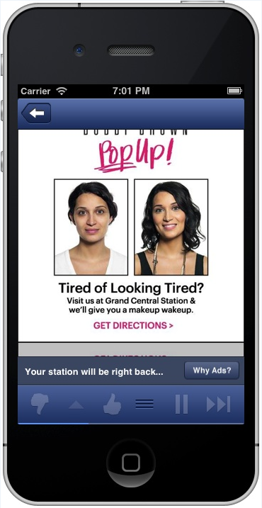
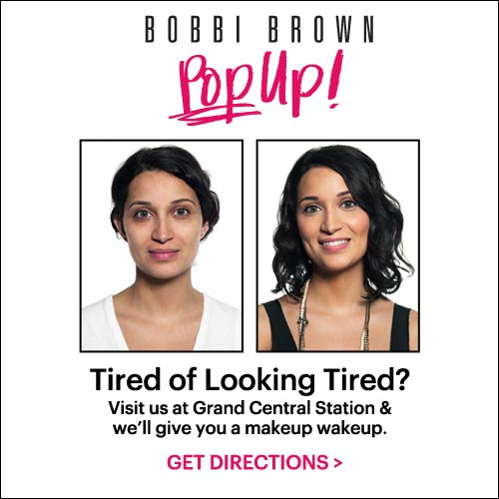

Audio Ad
Bobbi Brown Pretty Powerful Campaign
“Hey New Yorkers, I’m Bobbi Brown and I’ve just opened my first pop-up store at Grand Central in the Lexington Passage.
If you’re tired of looking tired, stop by and my makeup artist will show you my secret of the universe.
Click the banner for directions and don’t forget to check-in on Facebook for exclusive offers.”
1

Slide 2
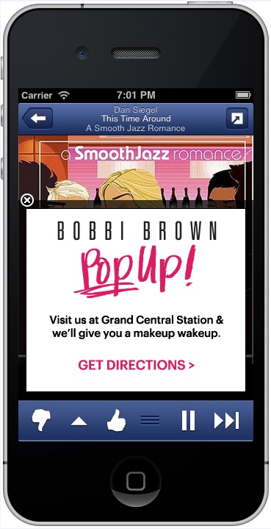
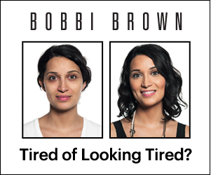
300x250 Animated Creative
Bobbi Brown Pretty Powerful Campaign
Frame 1
Frame 2
2

Slide 3
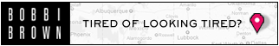
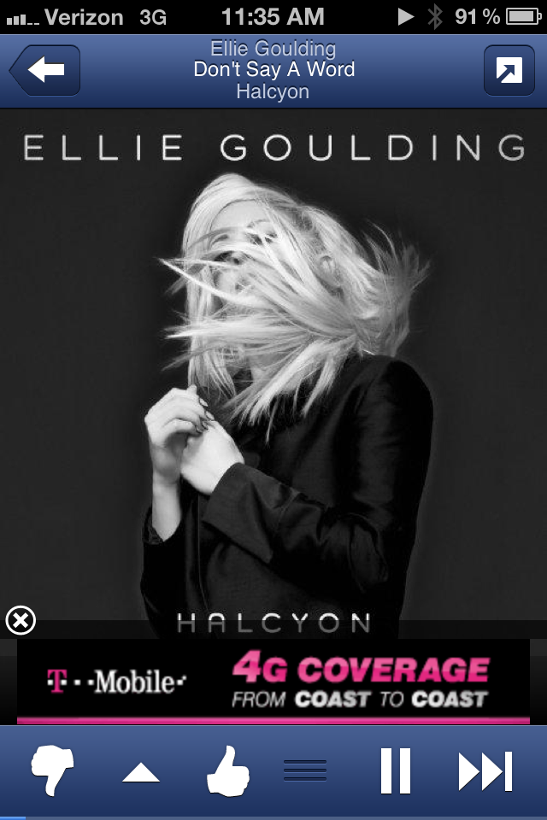

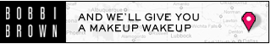
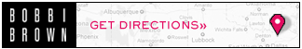
320x50 Animated Creative
Bobbi Brown Pretty Powerful Campaign
Frame 1
Frame 2
Frame 3
Frame 4
3

Slide 4
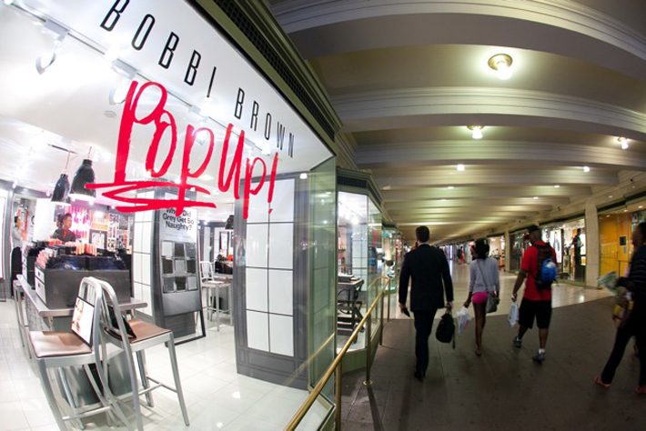
Pop-up store
Bobbi Brown Pretty Powerful Campaign
4

Slide 5
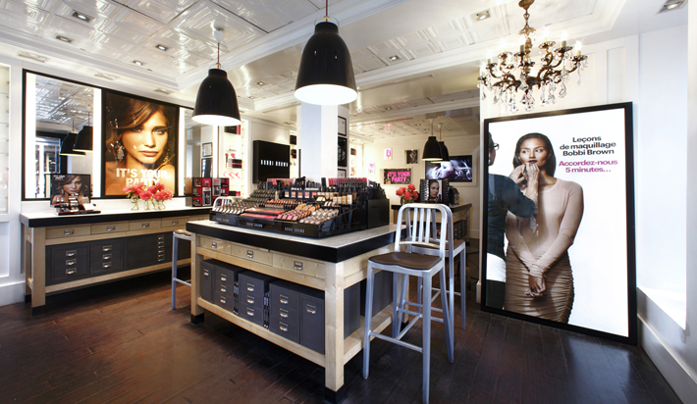
Pop-up store
Bobbi Brown Pretty Powerful Campaign
5

